Slide 1
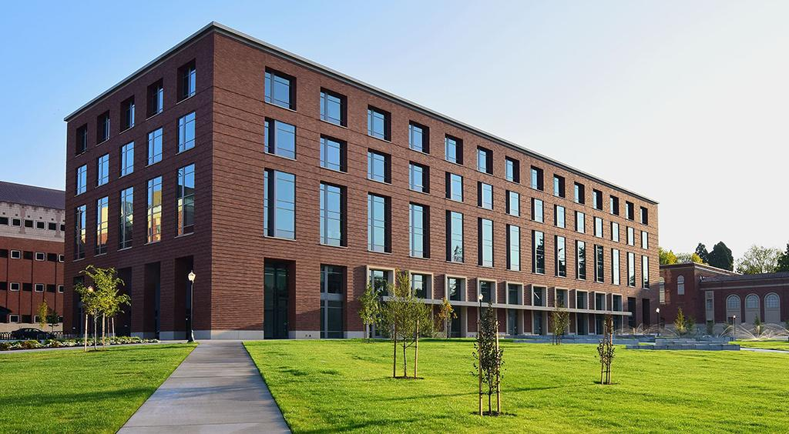

Honors College
App
Adrien Protzel, Benjamin Hutkoff, Chitali Buge, and
Erick Branner
Notes:
Integration qualtrics, hand-off user feedback to design

Slide 2
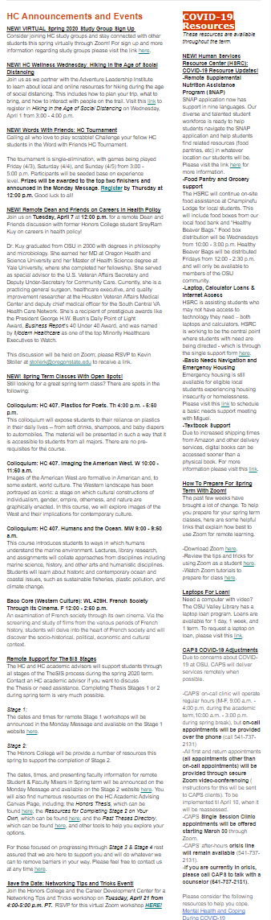

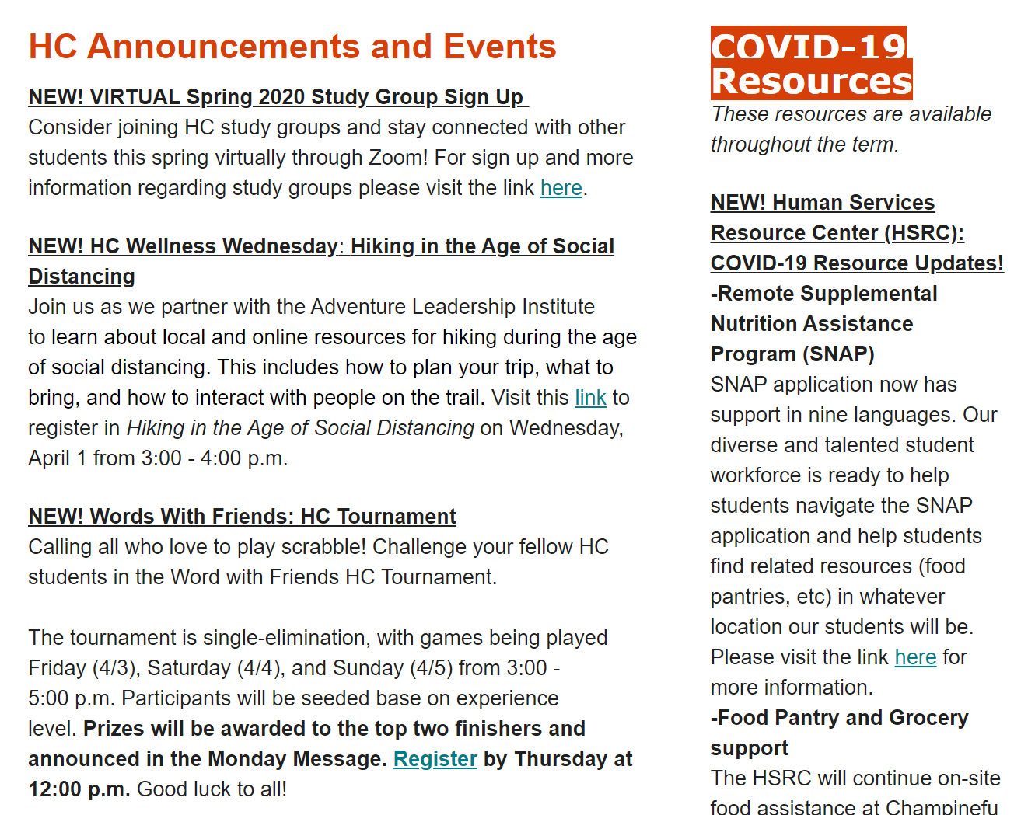
Existing Solution

Slide 3
Project Breakdown
Sprint | Task Title | Time (wk)
1 | Medium Fidelity Prototype | 3
2 | Research (Creating Persona, incorporating existing app designs) | 3
3 | High-fidelity Prototype Draft 1 | 3
4 | User Testing Round 1 | 3
5 | High-fidelity Prototype Draft 2 | 2
6 | User Testing Round 2 | 3
7 | High-fidelity Prototype Draft 3 | 3
8 | High-fidelity Admin Prototype | 3
9 | High-fidelity Prototype Final Draft | 3
10 | Project Wrap Up | 2
Notes:
TM1 - adrien
TM2- ben
TM3- erick
TM4 - me

Slide 4
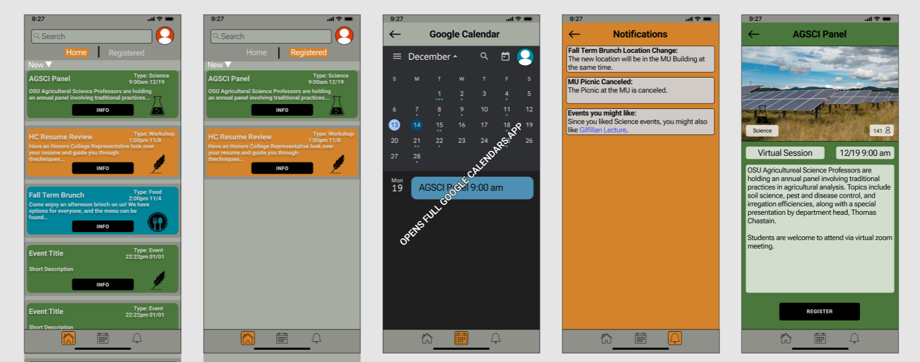
App Prototype
Notes:
TM1 - adrien
TM2- ben
TM3- erick
TM4 - me

Slide 5
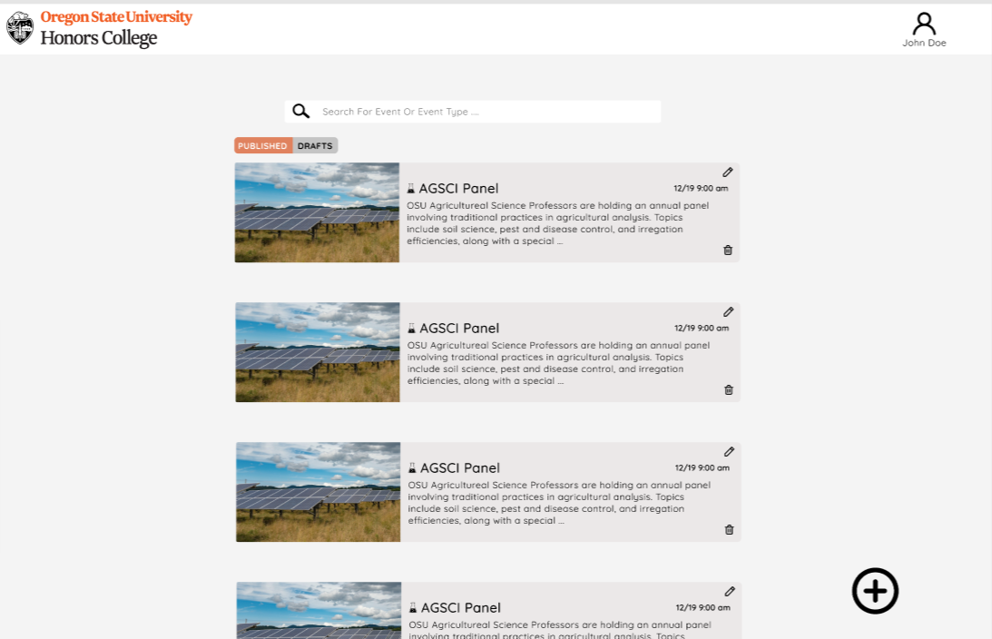
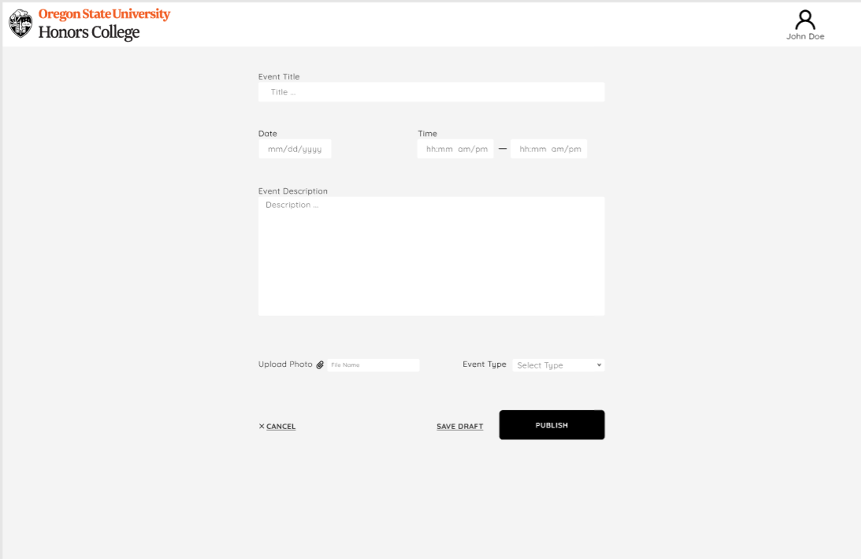
Admin Web Prototype
Notes:
TM1 - adrien
TM2- ben
TM3- erick
TM4 - me

Slide 6
Questions
?
Thank you for listening

